Slide 1
Neural Network
s

Slide 2
Feed-forward
Neural Network

Slide 3

Feed-forward
Neural Network
High Fashion Home browse data
Divided into product groups per customer
Subdivided at browsing pauses > 30 min

Slide 4
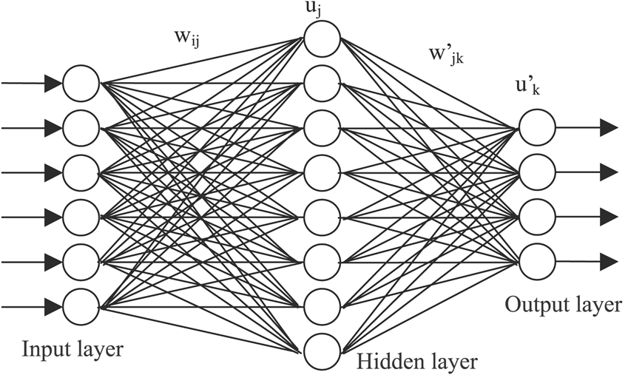
Feed-forward
Neural Network

Slide 5





Feed-forward
Neural Network

Slide 6



Feed-forward
Neural Network

Slide 7

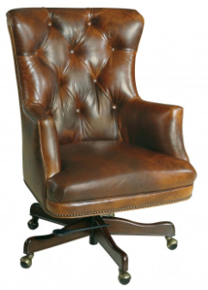


Feed-forward
Neural Network

Slide 8



Slide 9
machine learning python package
API interface for other libraries:
— Tensorflow, CNTK, Theano

Slide 10

using

Slide 11
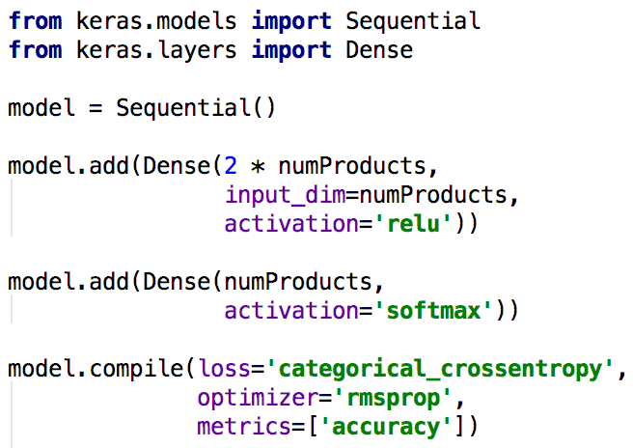

Slide 17
epoch
- one complete pass through all training data
batch size
- amount of training data to consider before updating model weights
- higher batch size gives better results, but takes more RAM

Slide 19
X

Slide 20

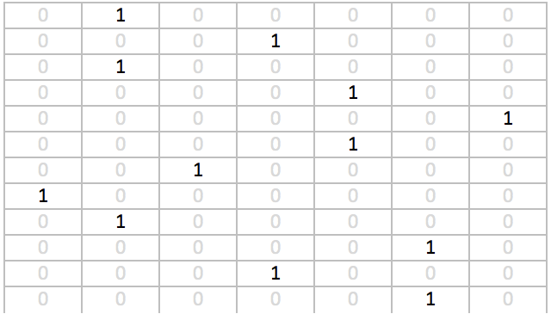
X

Slide 21
X
training
samples

Slide 22
X
training
samples

Slide 23
y
X
training
samples

Slide 24
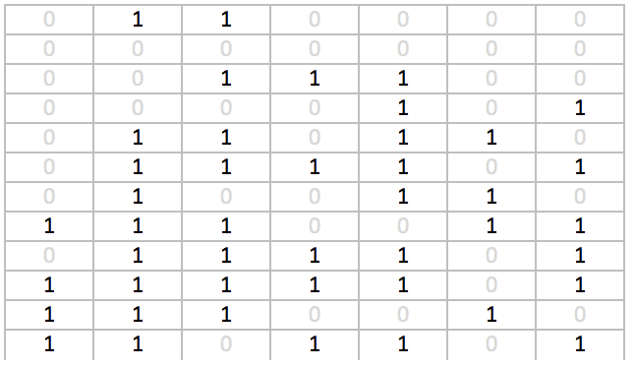
y
X
training
samples

Slide 25
y
X
training
samples

Slide 26
y
X
training
samples

Slide 27
y
X
training
samples

Slide 28
y
X
training
samples

Slide 29
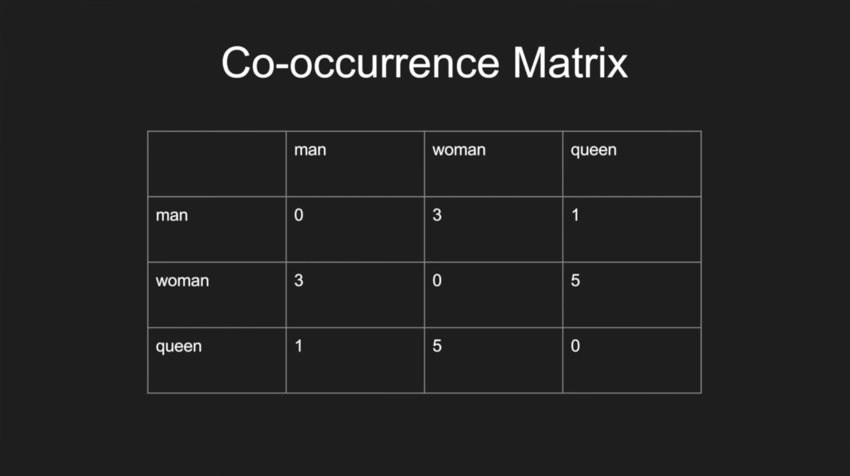
should have used:
Word Embeddings
GloVe
word2vec

Slide 30
should have used:
Word Embeddings
GloVe
word2vec

Slide 31
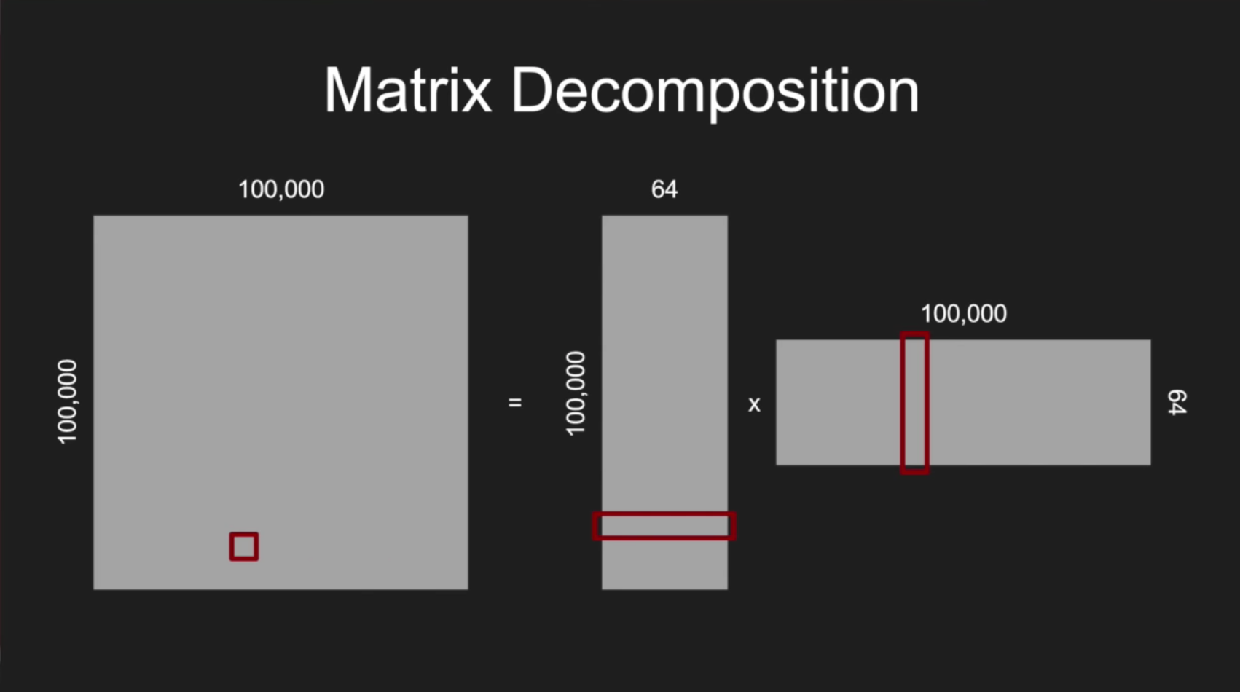
should have used:
Word Embeddings
GloVe
word2vec

Slide 32
should have used:
Word Embeddings
GloVe
word2vec
gets you
[0.23, 0.65, 0.12, 0.84, 0.34]
instead of
[0, 0, 0, 0, 0, 0, 0, 0, 0, 1, 0, 0, … 0, 0, 0, 0, 0, 0, 0, 0, 0, 0, 0]
(for example)

Slide 33
epoch = 1 complete pass through all training data
more is better?

Slide 34
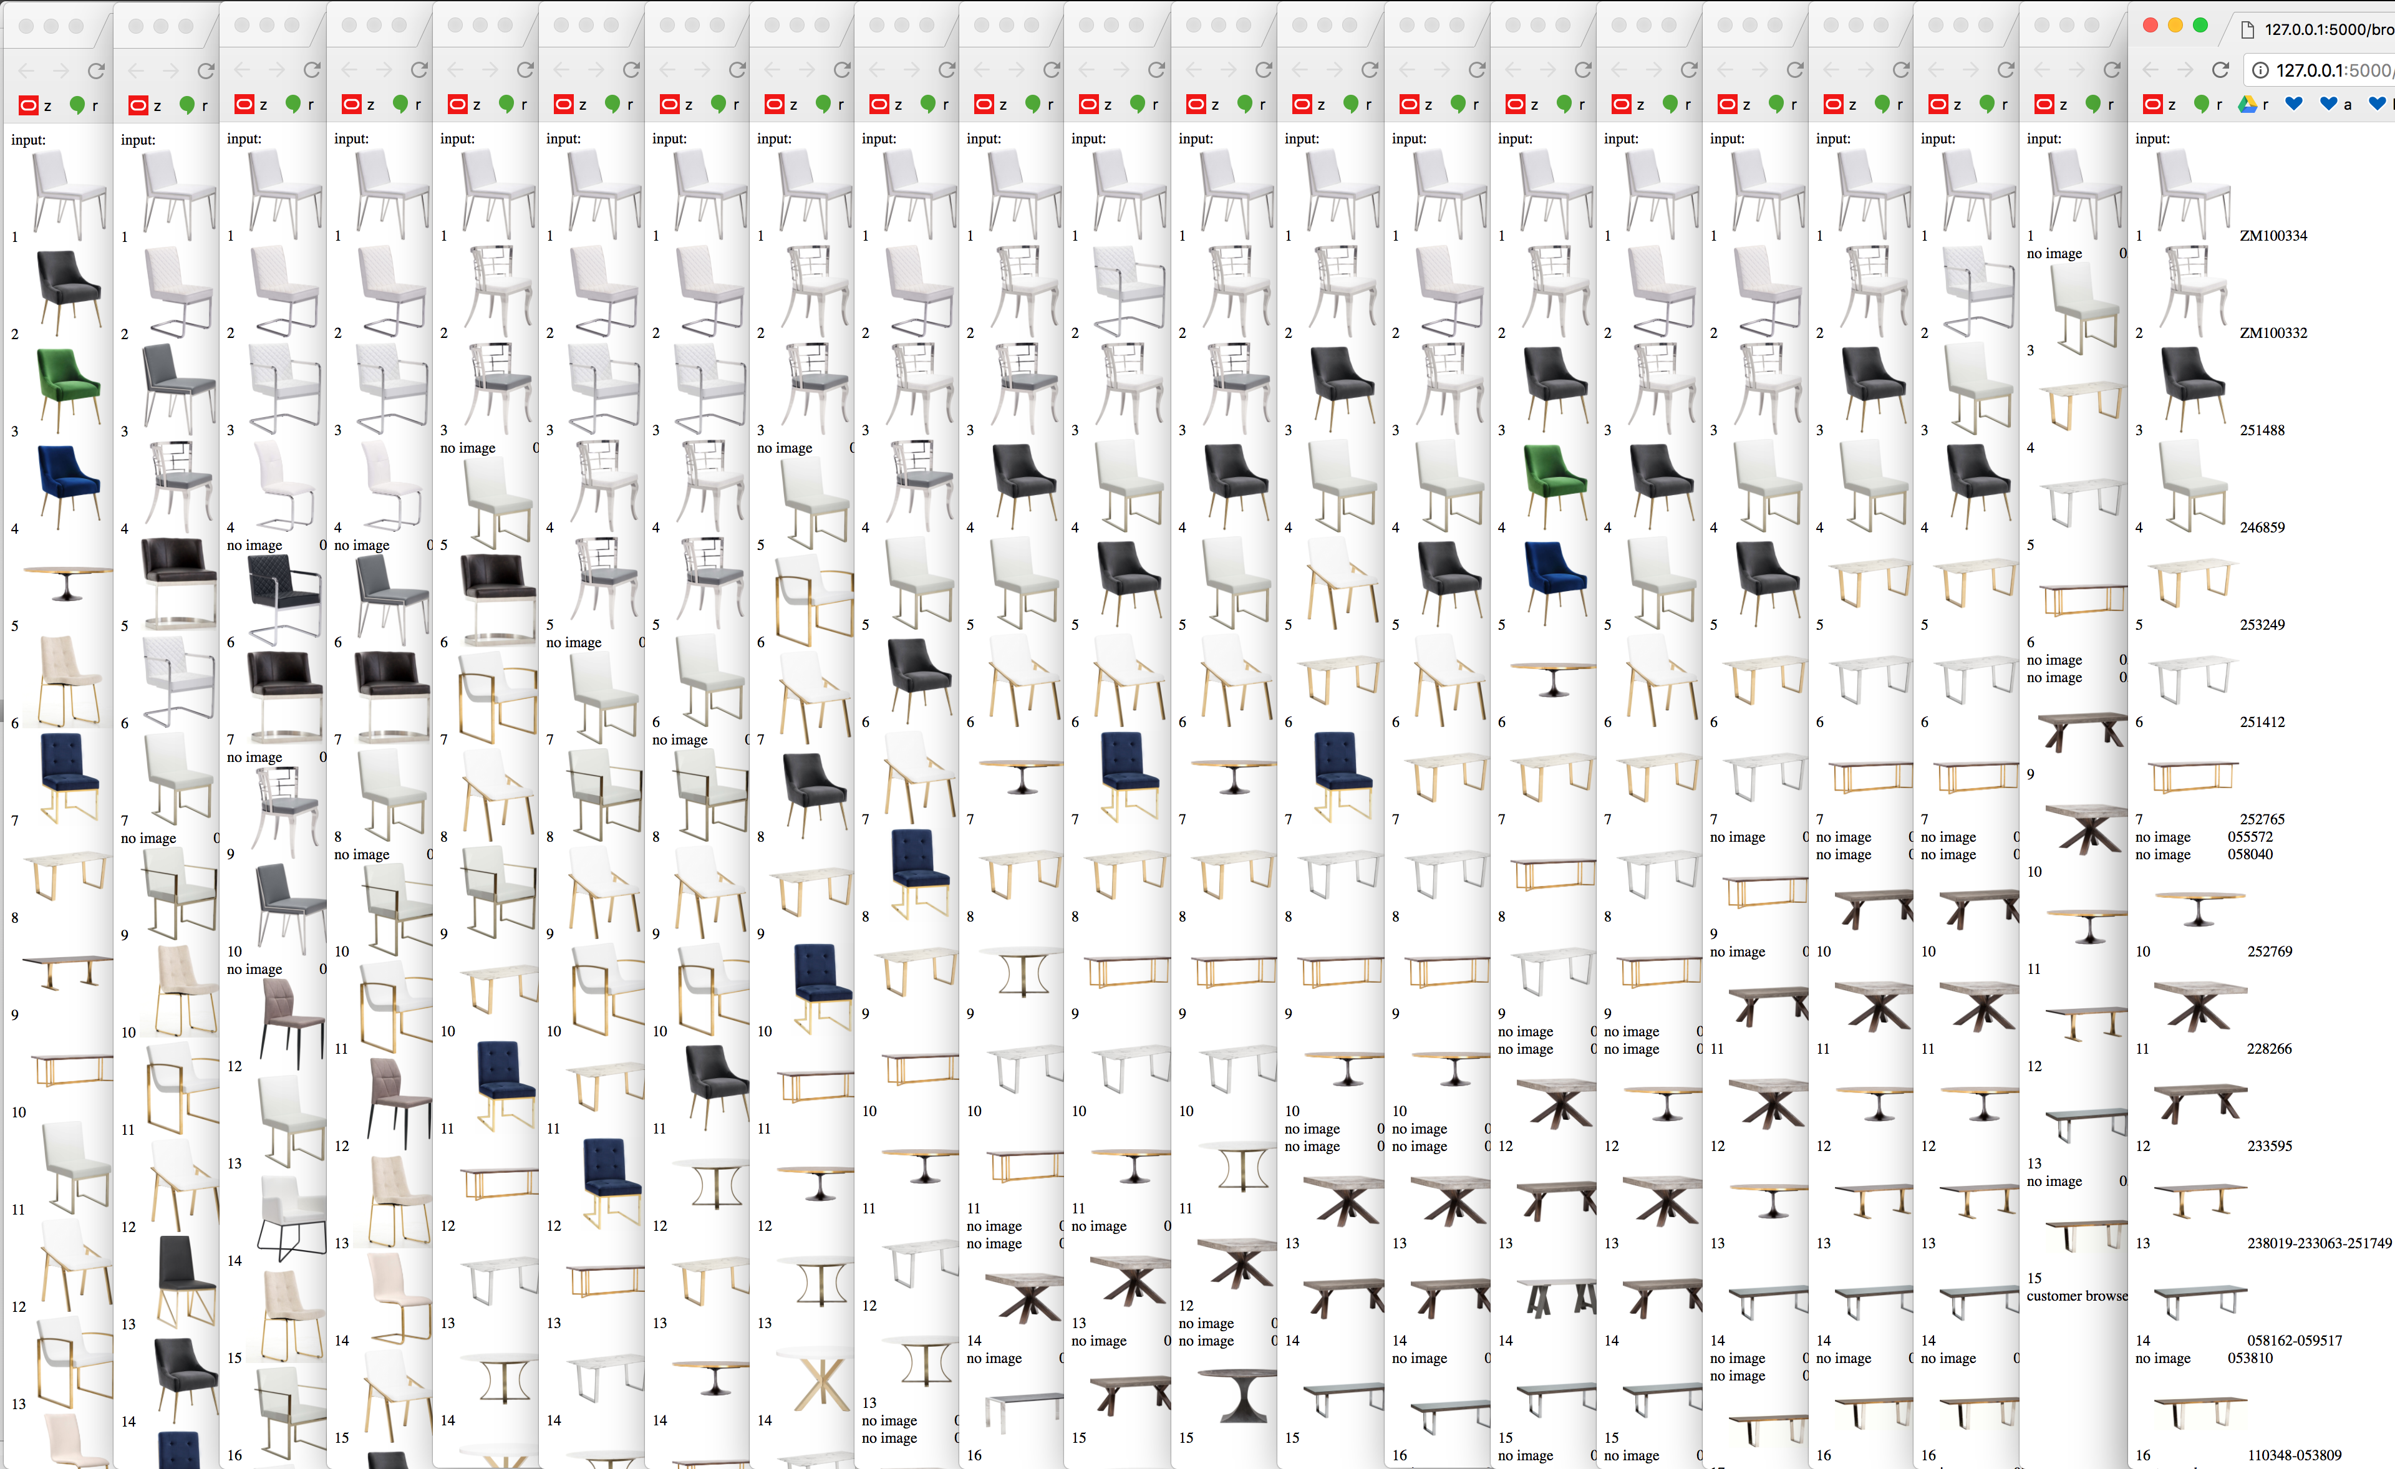
epoch = 1 complete pass through all training data

Slide 35
epoch = 1 complete pass through all training data
1 2 3…
epochs

Slide 36
epoch = 1 complete pass through all training data
1 2 3…
epochs

Slide 37
epoch = 1 complete pass through all training data
1 2 3…
epochs

Slide 38
neural network model file: 1.2 GB
(not feasible for production)
maybe using product embedding would help?

Slide 39





Slide 40
thoughts
Easier than React
Official routing
Official state management
Templates (easier to read/manage than JSX)
full CSS allowed per component

Slide 41
